Slide 1
-
Deep Learning AI
Andrew Kuruvilla
ITAI 2376 Deep Learning in Artificial Intelligence

Slide 2
Introduction
Course Overview
This course covers fundamental and advanced topics in Artificial Intelligence, integrating theoretical knowledge with practical applications.
Spanning from basics like neural networks to complex systems in deep learning, NLP, and computer vision.
Equip students with the skills to design, analyze, and implement AI solutions across various domains.
Personal Objectives
Goal for Enrolling: To deepen my understanding of AI technologies and their real-world applications, enhancing both my theoretical knowledge and practical skills.
Expected Outcomes: By the end of this course, I aim to proficiently build and deploy AI models, contribute to innovative AI projects, and prepare for advanced roles in technology.

Slide 3
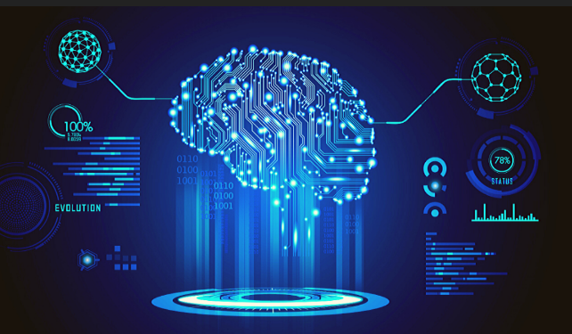
Module 1 - Deep Learning Fundamentals
Key Points Learned
Examined the structure and activity of artificial neurons: inputs, weights, biases, and activation functions.
Explored various architectures for neural networks, from very simple single-layer perceptrons up to very complex multilayer perceptions.
realized the concepts related to backward propagation and loss functions that are crucial in the training of neural networks.
Explored optimization techniques used by the likes of Stochastic Gradient Descent and Adam Optimizer.
Discussed the challenges of the neural network such as high data requirements, extensive computational resources, and model interpretability issues.
Activities and Results
Participated in hands-on labs creating neural networks for digit recognition.
Engaged in group discussions to deepen understanding of deep learning impacts.
Link: Deep Learning Projects
Relevance: This repository includes implementations of basic deep learning models, providing a practical foundation for the theoretical concepts introduced in this module.
Notes:
Reflection
Grasping the mathematical foundations of neural networks was initially challenging. I dedicated extra hours to studying resources outside the classroom, which clarified concepts like gradient descent and loss functions. This perseverance not only enhanced my comprehension but also my ability to apply these concepts practically.

Slide 4
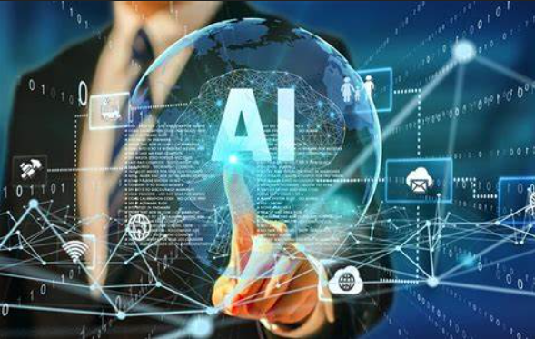
Module 2 - Tools and Environments for AI
Key Points Learned
Gained proficiency with AI frameworks and libraries such as TensorFlow, PyTorch, and Keras for building and training models.
Learned to utilize virtual environments and manage dependencies to streamline development workflows.
Evaluated the benefits of using cloud-based AI services like AWS SageMaker and Google AI Platform for scalable machine learning applications.
Explored techniques for efficient model training and deployment using GPU and TPU resources.
Addressed the importance of version control and collaboration tools in managing AI projects.
Activities and Results
Configured TensorFlow environments and ran initial training models.
Collaborated on a cloud-based project to understand the scalability of AI tools.
Link: AI Tools and Environments
Relevance: Showcases the setup and use of AI development tools like TensorFlow and PyTorch, demonstrating practical applications of these tools as covered in the module.
Notes:
Reflection
Initially overwhelmed by the variety of tools available, I focused on mastering TensorFlow through additional tutorials and peer collaboration. This targeted approach not only built my confidence but also my proficiency, enabling me to help others in my cohort.

Slide 5
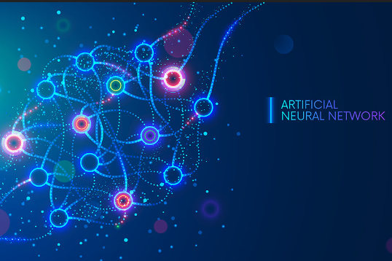
Module 3 - Neural Network Basics
Key Points Learned
Explanation on the different types of layers in a neural network, including convolutional, pooling, and fully connected, was provided.
Explored how data preprocessing techniques, such as normalization and augmentation, would support learning improvement within the model.
learned the key critical points in model evaluation using metrics like accuracy, precision, recall, and F1 score.
Presented and discussed such advanced concepts as dropout, batch normalization, and the other ways there may be to regularize models.
Analyzed some common issues in training deep neural networks, such as vanishing and exploding gradients, and how to mitigate them.
Activities and Results
Built basic neural network models to classify text data.
Engaged in a capstone project, optimizing neural network parameters to improve accuracy.
Link: Neural Network Implementations
Relevance: Features basic neural network models illustrating the architecture and data preprocessing techniques crucial for model optimization as discussed in the module.
Notes:
Reflection
The complexity of neural network architectures was initially daunting. By breaking down each component and experimenting with different structures in labs, I developed a robust understanding and practical skills in neural network optimization.

Slide 6

Module 5 - Convolutional Neural Networks
Key Points Learned
Mastered the theory and application of convolutional layers for feature detection and extraction in images.
Learned about pooling strategies (max pooling and average pooling) to reduce spatial dimensions while preserving key features.
Studied the implementation of advanced CNN architectures like LeNet, AlexNet, and VGG for deep learning tasks.
Explored real-world applications of CNNs in areas such as medical image analysis, autonomous driving, and facial recognition systems.
Analyzed methods for visualizing and interpreting CNNs to understand model decisions and improve transparency.
Activities and Results
Implemented CNNs for a facial recognition project.
Analyzed performance improvements by adjusting network architectures.
Link: CNN Projects
Relevance: This link leads to projects involving CNN applications in image processing, directly applying the concepts of convolutional layers and feature extraction mechanisms taught in this module.
Notes:
Reflection
The initial transition to CNNs presented a steep learning curve due to their complexity. Through continuous practice and by conducting multiple experiments for my projects, I gained a deep understanding of how to effectively utilize CNNs in image-related tasks.

Slide 7

Module 6 - Network Engineering
Key Points Learned
Overview of neural network architectures, including CNNs and RNNs.
Importance of data structure for computer vision and NLP applications.
Introduction to new architectures with weight sharing for efficiency.
Discussion on convolutional and recurrent neural network features.
Exploration of the impact of architecture on network performance.
Activities and Results
Participated in labs implementing CNNs for image analysis.
Analyzed the performance impact of different network architectures.
Engaged in group projects to design RNNs for time-series prediction.
Link: Network Engineering Examples
Relevance: Includes projects exploring various neural network architectures, demonstrating optimization techniques and their impact on performance as discussed in the module.
Notes:
Reflection
Understanding the implications of neural network architecture was initially overwhelming due to its complexity. Through hands-on labs and collaborative projects, I began to appreciate how architecture choices directly affect performance and efficiency. This deep dive into network engineering significantly enhanced my analytical skills and my understanding of practical AI applications.

Slide 8

Module 7 - Natural Language Processing (NLP)
Key Points Learned
Grasped core NLP techniques such as syntactic parsing, semantic analysis, and entity recognition.
Learned to implement and train models for machine translation and automated summarization.
Studied the use of context-based models like BERT for improving the understanding of language nuances.
Explored sentiment analysis tools to gauge consumer opinions and emotions from text data.
Examined the challenges of linguistic diversity and ambiguity in natural language processing.
Activities and Results
Developed an NLP model to identify sentiment in social media posts.
Analyzed different text preprocessing techniques to enhance model accuracy.
Participated in workshops on advanced NLP tools and their applications.
Link: NLP Applications
Relevance: Showcases NLP techniques such as tokenization and sentiment analysis applied in practical projects, reflecting the detailed discussion of processing and analyzing textual data in this module.
Notes:
Reflection
The complexities of natural language posed significant challenges, especially understanding context and sarcasm. By experimenting with various preprocessing techniques and learning from case studies, I improved my ability to design models that more accurately interpret human language. This module profoundly affected my approach to AI, making me more thoughtful about the nuances of language.

Slide 9
Module 8 – Processing Text
Key Points Learned:
Importance of text preprocessing and vectorization in machine learning.
Techniques for cleaning and preparing textual data for analysis.
Exploration of tokenization, stop words removal, and vectorization methods.
Application of TF-IDF and bag-of-words models in text classification.
Review of machine learning workflows incorporating text data.
Activities and Results:
Implemented a text classification system using vectorization techniques.
Explored various text normalization processes to enhance data quality.
Participated in a collaborative project on automated document categorization.
Link: Text Processing Techniques
Relevance: Demonstrates text preprocessing techniques essential for NLP applications, aligning with the module’s focus on preparing textual data for complex AI tasks.
Notes:
Reflection
Initially, the diversity of text data formats and the need for extensive preprocessing were daunting. Through practical assignments and iterative testing, I mastered techniques that significantly enhance the quality of text data for machine learning models. This module was instrumental in developing my skills in handling and analyzing textual data effectively.

Slide 10
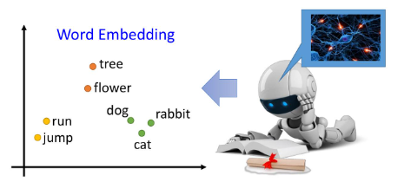
Module 9 - Word Embeddings
Key Points Learned:
Understood the mathematical foundations and implementation of models like Word2Vec and GloVe.
Analyzed how embeddings capture contextual meanings within a large corpus.
Explored the use of embeddings in improving the performance of various NLP tasks.
Learned techniques to visualize and interpret word embeddings to better understand model behavior.
Discussed the limitations of word embeddings and ongoing research areas to address these challenges.
Activities and Results:
Developed a language model using GloVe for semantic similarity analysis.
Evaluated different embedding techniques in a series of NLP tasks.
Conducted a comparative study on the effectiveness of various embeddings.
Link: Word Embeddings Use Cases
Relevance: Features projects that implement Word2Vec and GloVe, illustrating their use in enhancing semantic understanding in NLP models as explored in this module.
Notes:
reflection
Grasping the subtleties of word embeddings and their implementation was challenging. By engaging in hands-on projects and deep discussions, I gained a solid understanding of how embeddings capture linguistic patterns. This knowledge has been crucial for advancing my proficiency in building more nuanced NLP models.

Slide 11
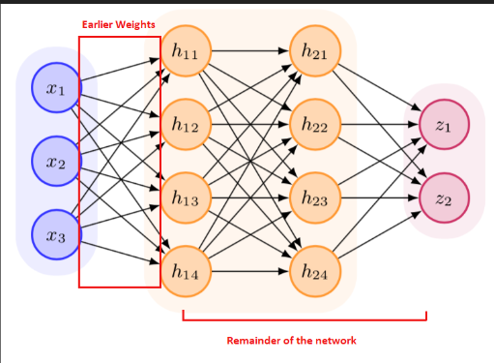
Module 10 - Recurrent Neural Networks and LSTM
Key Points Learned:
Explored architecture and how the RNN operates, and their ability to process sequenced data.
Mastering the way to implement LSTMs in place of RNNs to overcome their limitations.
Explored practical applications in speech recognition and music generation using RNNs and LSTMs.
Techniques to tune and optimize the RNNs for enhanced performance and accuracy have been discussed.
Investigated for recent alternatives to RNNs, including GRUs and attention mechanisms, in the treatment of sequence data.
Activities and Results:
Implemented an LSTM model for a sequence prediction task in finance.
Analyzed the performance of RNNs in natural language processing.
Participated in a workshop on advanced recurrent network architectures.
Link: RNN and LSTM Projects
Relevance: Contains projects using RNNs and LSTMs for time-series prediction, showcasing their application in processing sequential data, a central theme of this module.
Notes:
reflection
The concept of 'memory' within neural networks, particularly through LSTMs, was fascinating but complex. My initial struggles with understanding how information persists across time steps were mitigated by iterative learning and model experimentation. This module significantly enhanced my understanding of dynamic neural architectures and their practical applications in AI.

Slide 12
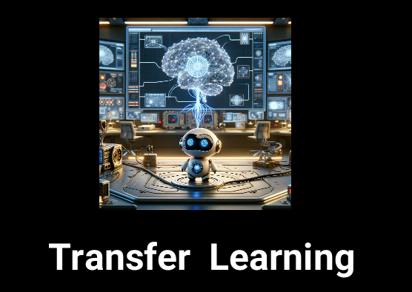
Module 11 - Transformers
Key Points Learned:
Learned the revolutionary transformer architecture including self-attention mechanisms that have reshaped modern NLP.
Studied the implementation of transformers in tasks requiring an understanding of long-range dependencies in text.
Explored the scalability of transformers and their efficiency compared to previous models like LSTMs.
Analyzed case studies where transformers have been successfully applied, such as in the GPT and T5 models.
Activities and Results:
Developed a transformer model for language translation.
Participated in workshops on fine-tuning pre-trained transformer models for specific NLP tasks.
Explored the implementation of transformer models in text summarization.
Link: Transformers in NLP
Relevance: This repository includes implementations of transformers in various NLP tasks, highlighting their revolutionary approach to handling sequence-to-sequence models, as discussed in the module.
Notes:
Reflection:
Initially, the complexity of transformer architecture, especially the self-attention mechanism, was quite challenging. Through practical coding exercises and group discussions, I gained a deeper understanding of its components. By applying these models to real-world NLP tasks, I appreciated their efficiency and effectiveness in handling sequence data compared to traditional methods.

Slide 13
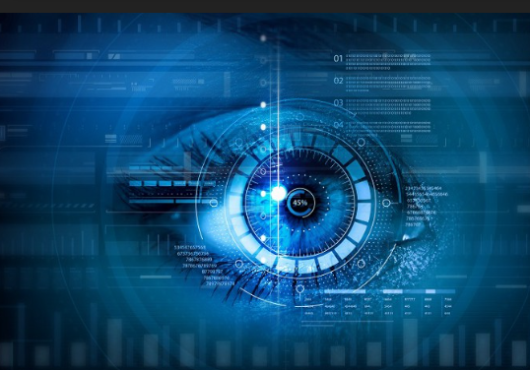
Module 12 - Computer Vision
Key Points Learned:
Basics of computer vision and image processing.
Techniques in image classification, object detection, and semantic segmentation.
How computers interpret images as arrays of pixel values.
Application of convolutional neural networks (CNNs) in computer vision.
Advances in real-time image processing technologies.
Activities and Results:
Built and trained a CNN for facial recognition.
Analyzed different computer vision models for object detection in video streams.
Engaged in a project to improve semantic segmentation techniques using deep learning.
Link: Computer Vision Showcase
Relevance: This repository includes projects that apply CNNs in real-world computer vision tasks, such as object detection and image segmentation, reflecting the content discussed in this module.
Notes:
Reflection: Delving into computer vision, the initial hurdle was understanding how to process and interpret image data effectively. Through various projects, I mastered the use of CNNs and their application in detecting and classifying objects. The practical exposure to advanced image processing tasks significantly enhanced my skills and understanding of this complex field.

Slide 14
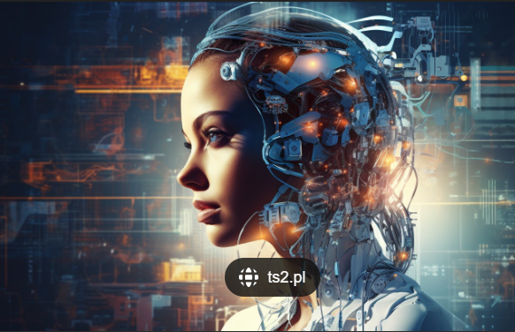
Module 13 - AI Agents
Key Points Learned:
rasped the concept of AI agents and their roles in automating decision-making processes.
Explored different types of AI agents, from simple rule-based systems to complex learning agents.
Learned how AI agents are applied in various industries for tasks such as automated trading, robotics, and personal assistants.
Discussed the integration of reinforcement learning with AI agents to enhance their decision-making capabilities.
Analyzed the societal impacts and ethical implications of autonomous agents in real-world scenarios.
Activities and Results:
Developed an AI agent for automated customer service interactions.
Participated in simulations testing AI agents in dynamic environments.
Explored the use of AI agents in healthcare for patient monitoring.
Link: AI Agents Framework
Relevance: Showcases development and testing of AI agents in simulation environments, highlighting their decision-making and learning capabilities as taught in the module.
Notes:
Reflection:
The concept of AI agents was fascinating but implementing them in realistic scenarios was challenging. By experimenting with different agent-based models and learning from real-world case studies, I was able to appreciate the potential and limitations of AI agents. This experience provided valuable insights into the practical aspects of AI technology.

Slide 15
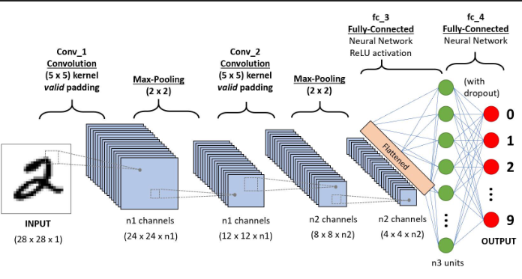
Module 14 - CNN Architectures and Transfer Learning
Key Points Learned:
Overview of various CNN architectures like AlexNet, VGG, and ResNet.
The concept and benefits of transfer learning in deep learning.
How to apply pre-trained models to new problems.
Techniques for optimizing CNNs for specific tasks.
Future trends in CNN development and application.
Activities and Results:
Applied transfer learning to enhance image classification models.
Compared the effectiveness of different CNN architectures on a standard dataset.
Engaged in a group project to design a custom CNN for a specific application.
Link: Advanced CNN Architectures
Relevance: Demonstrates the use of various advanced CNN architectures and transfer learning to enhance model performance in complex image processing tasks, aligning directly with the advanced topics covered in this module.
Notes:
Reflection:
Learning about advanced CNN architectures and transfer learning opened up new possibilities for optimizing model performance. Initially, choosing the right architecture for a task was daunting. Through hands-on practice and comparative analysis, I developed a systematic approach to selecting and adapting CNN models, greatly enhancing my problem-solving strategies in machine learning.

Slide 16
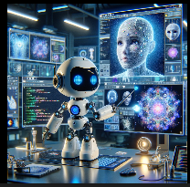
Conclusion
Summary of Skills and Knowledge Gained
Acquired a comprehensive understanding of deep learning, including foundational concepts and advanced topics such as convolutional neural networks (CNNs), natural language processing (NLP), and AI agents.
Gained practical experience through hands-on projects involving AI toolkits, neural network architectures, and the application of AI in real-world scenarios.
Developed strong technical skills in programming with Python, using TensorFlow and PyTorch, and applying transfer learning techniques to optimize model performance.
Career Applications:
Plan to leverage the deep learning skills in upcoming data science projects at my current job, focusing on improving predictive models and implementing AI-driven solutions.
Intend to explore opportunities in AI-focused roles that involve building and fine-tuning models for various industrial applications, such as healthcare for patient diagnosis and in retail for customer behavior prediction.
Aiming to contribute to open-source AI projects, which will help in solving complex problems while collaborating with a global community of developers.
Notes:
Overall Reflection
This course has significantly enhanced my problem-solving skills, particularly when working with complex data and algorithms. It encouraged me to think critically about applying theoretical concepts in practical settings, which has been invaluable. As I grew more confident in my ability to dissect and understand advanced AI concepts that once seemed daunting, I've become better prepared for continuous learning and adaptation in the rapidly evolving field of AI. Looking ahead, I plan to deepen my expertise in specific areas such as reinforcement learning and generative adversarial networks (GANs), aiming to broaden my capabilities in creating innovative AI solutions. I am committed to staying updated with the latest research and developments in AI by regularly attending workshops and conferences, and engaging in continuous education. Additionally, I aim to achieve certifications in advanced AI and machine learning courses to further credentialize my skills and contribute authoritatively to the tech community.

Slide 17
Bibliographies
Module 1: Deep Learning Fundamentals
Module 2: Tools and Environments for AI
Module 3: Neural Network Basics
Module 5: Convolutional Neural Networks (CNNs)
Module 6: Recurrent Neural Networks (RNNs)
Module 7: Network Engineering
Module 8: Natural Language Processing (NLP)
Module 9: Text Processing Techniques
Module 10: Transformers and Advanced Models
Module 11: Recurrent Neural Networks and LSTMs
Module 12: Advanced Topics in Computer Vision
Module 13: AI Agents and Multi-agent Systems
Module 14: CNN ARCHITECTURE

Slide 18
Link to github
https://github.com/drewvilla1/Final-portfolio-Deep-Learning-

